Slide 1

Managing Fire: wildfire prevention by gathering data, informing and training local communities
Team members: Nikoloz Mujirishvili, Alexandre Zaalishvili, Irakli Oqropiridze, Giorgi Sidamonidze, Luka Tavartqiladze

Slide 2
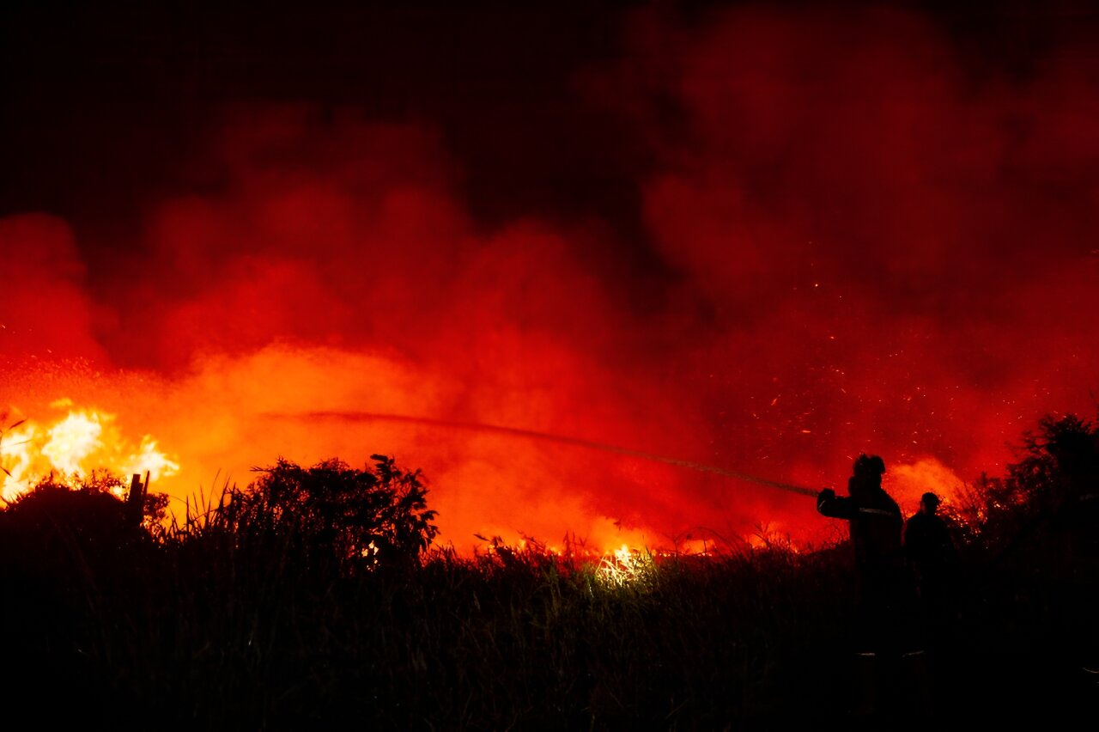
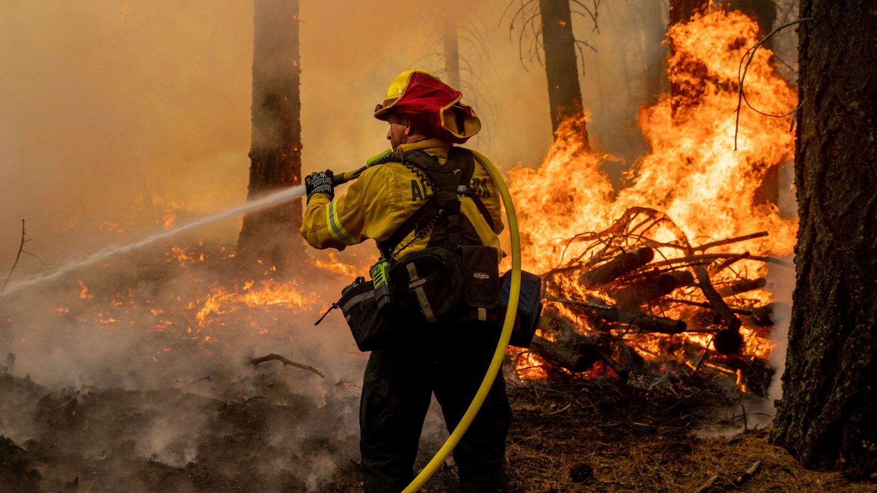
Colorado
Chile

Slide 3
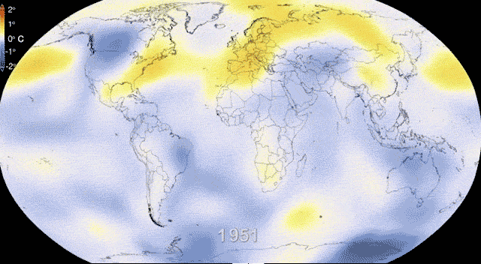

Slide 4
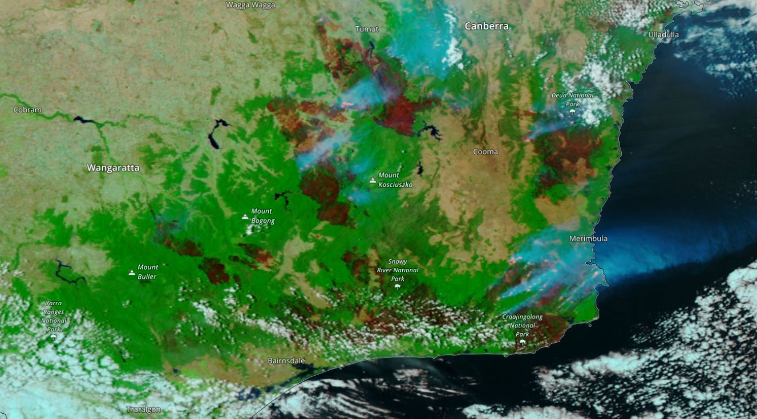
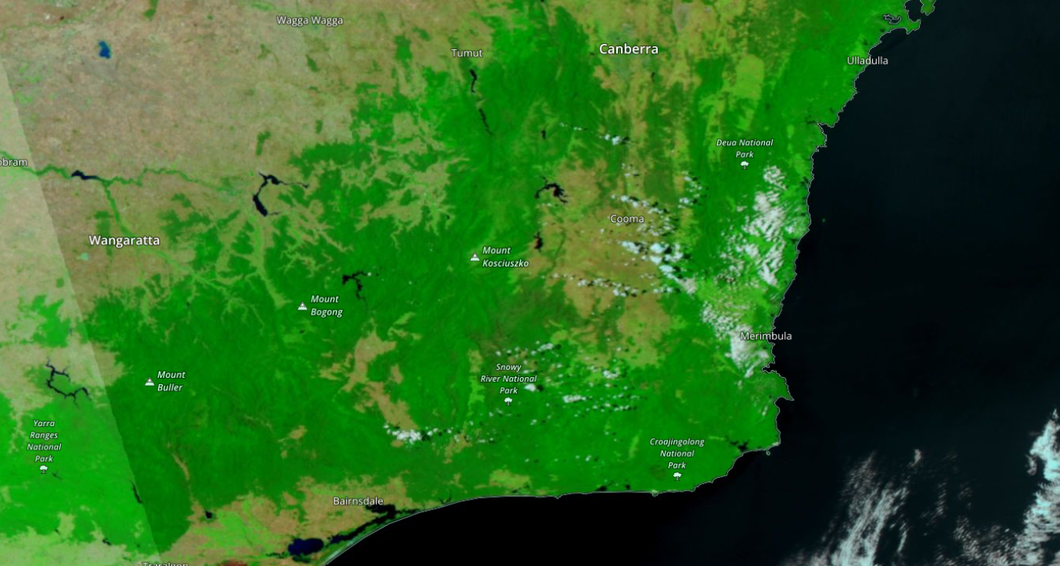
Australian Bushfire Jan 2019
Australian Bushfire Jan 2020

Slide 5
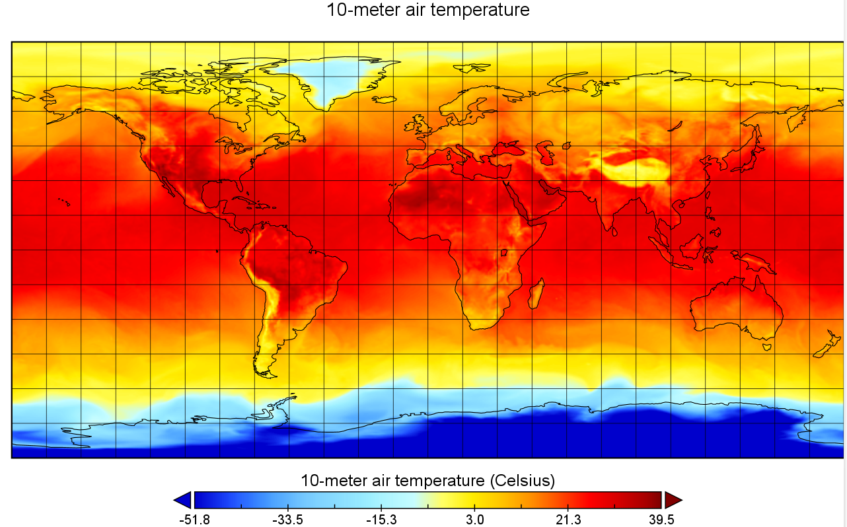


Slide 6
Fire Prevention Database
Satellite Images
Regional Climate Trends
Thermal sensors
Local Sources
We are not experts
Therefore we will help to inform the locals and provide assistance to the experts in the field

Slide 7
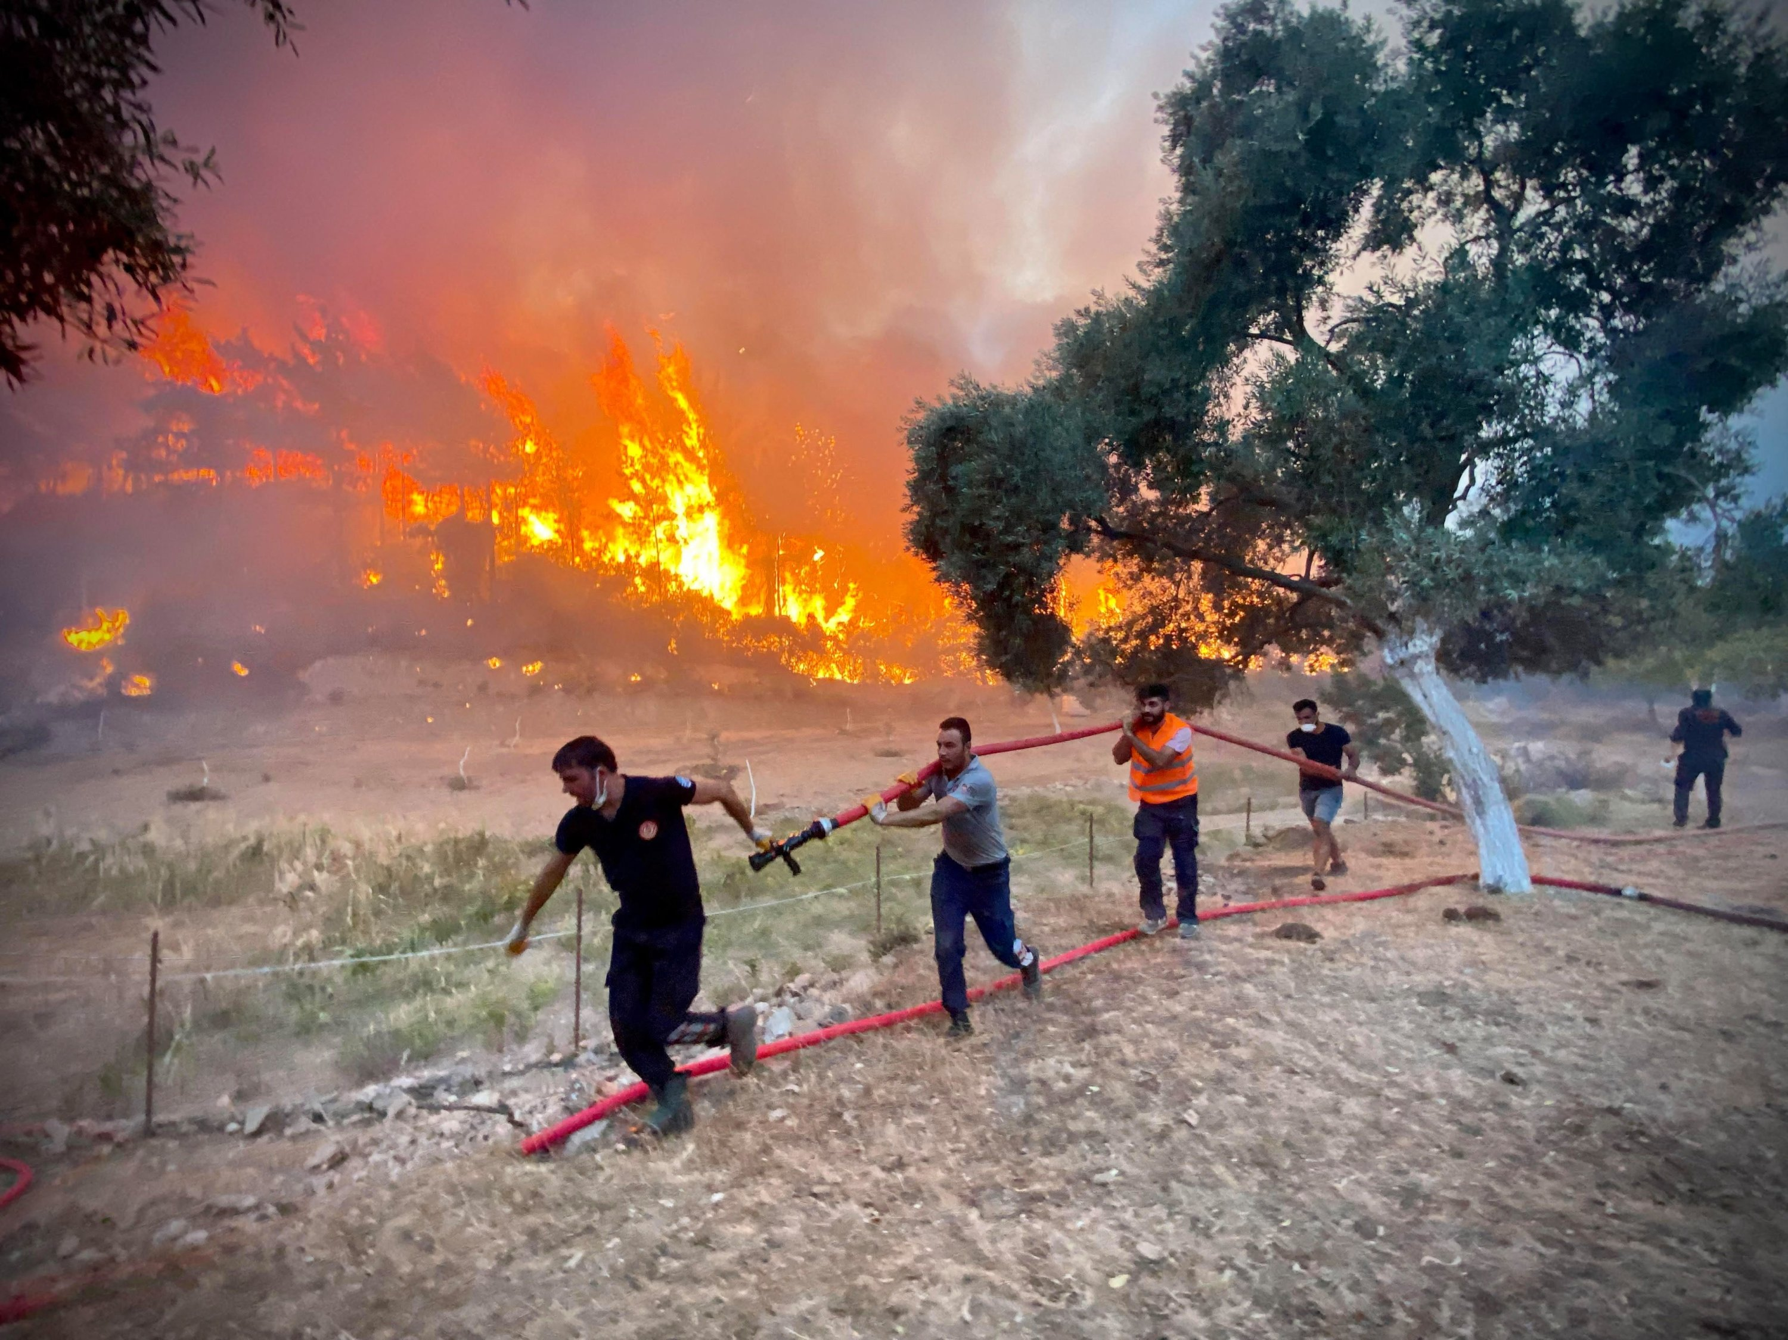

Slide 8
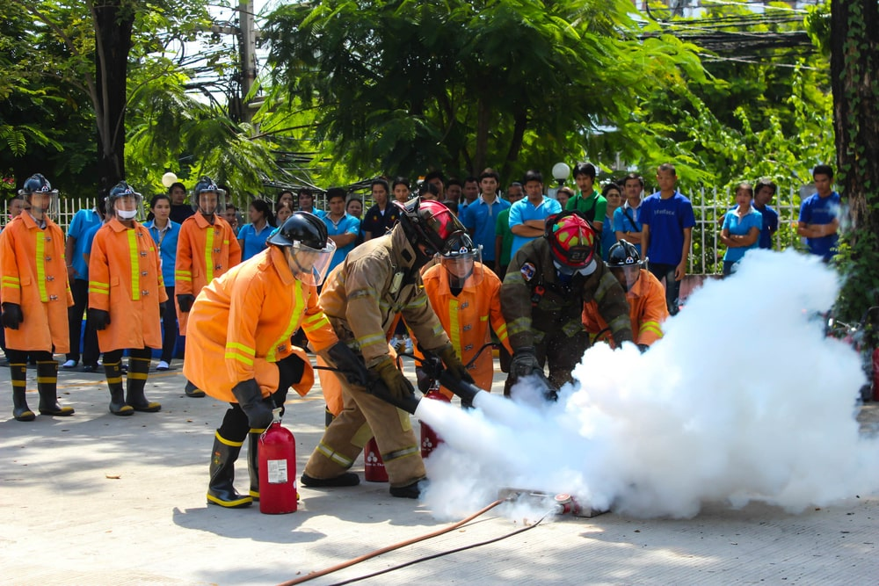

Slide 9
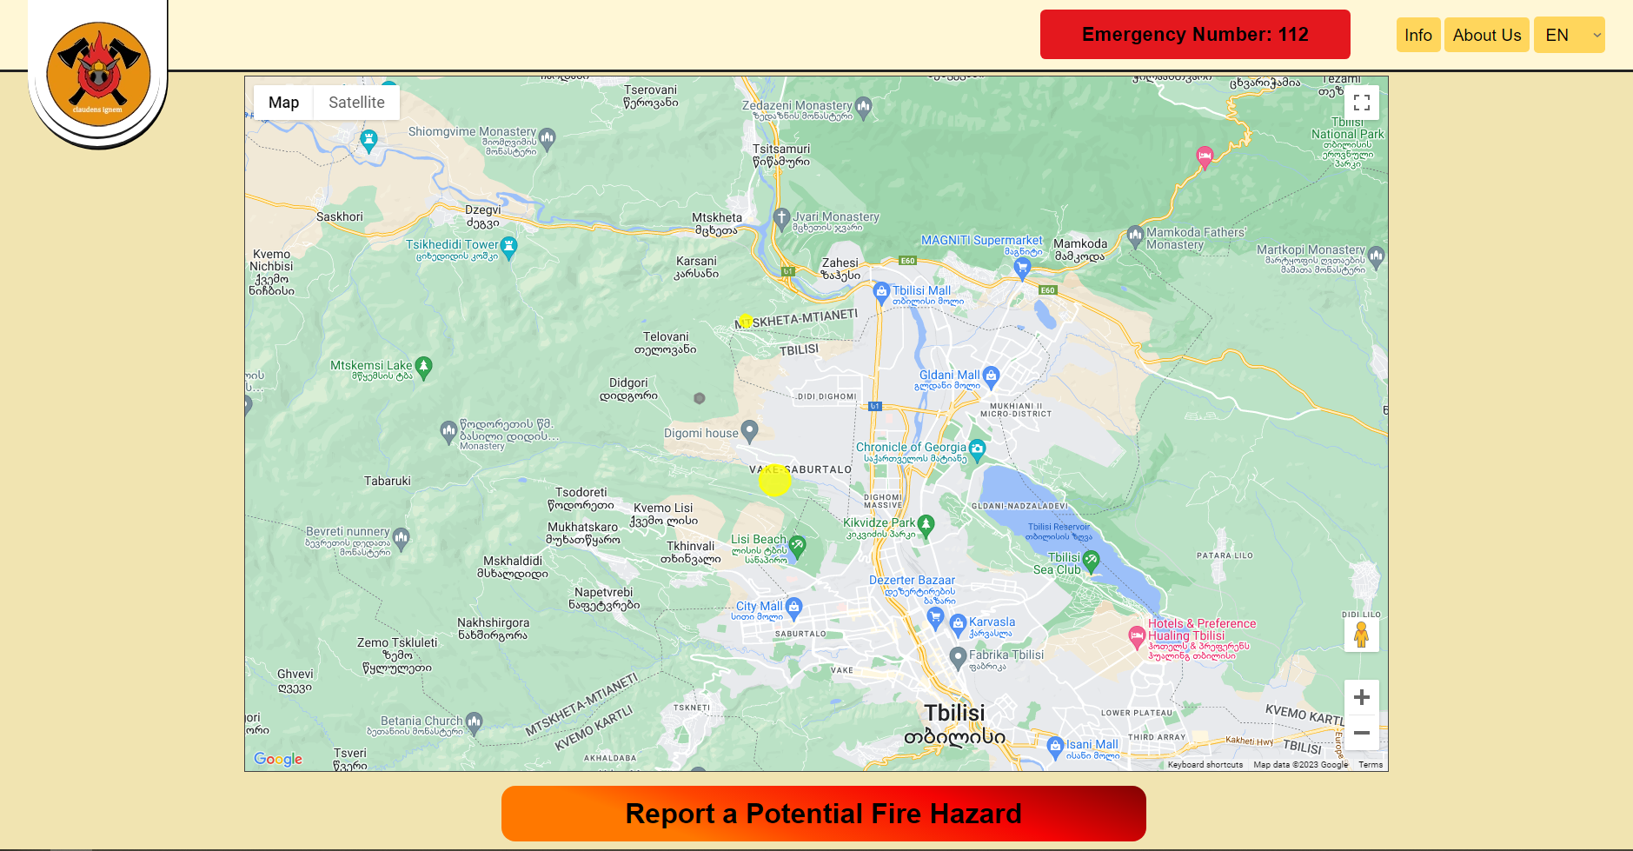

Slide 10

Thank you for your attention

